Slide 1
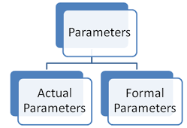
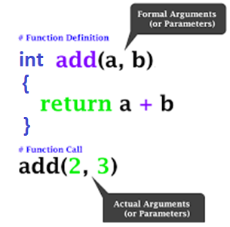
Types of parameters
1. FORMAL PARAMETERS
Parameters written in Function Definition is Called “Formal Parameter”. Formal parameters are always variables
2 . ACTUAL PARAMETERS OR ARGUMENTS
Parameters Written in Function Call is Called “Actual Parameter”

Slide 2
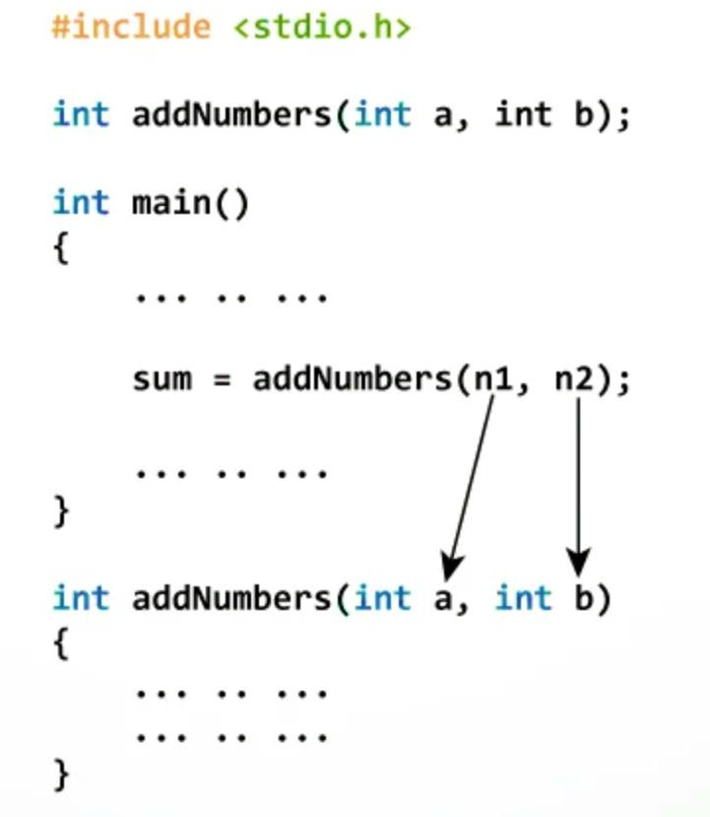
PARAMETER PASSING IN C
Parameter passing is the mechanism used to pass parameters to a function.
Parameters are the data values that are passed from calling function to called function.
TWO TYPES OF PARAMETER PASSING MECHANISMS:
Call by value
Call by reference or call by address

Slide 3
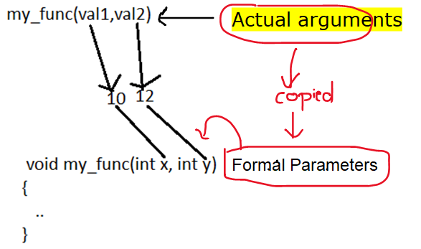
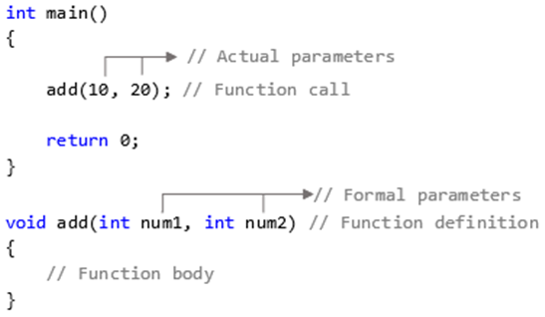
1.Call by value
In CALL BY VALUE function copies the actual value of an argument into the formal parameter of the function
i.e. in which values of the actual arguments are copied into the corresponding formal arguments of the called function

Slide 4
PARAMETER PASSING IN C – CALL BY VALUE
Changes made in the FORMAL ARGUMENTS in the function definition does not reflect on the values of the ACTUAL ARGUMENTS
#include <stdio.h> void main() { int a = 5,b; printf("\n before calling a = %d", a); b = increment(a); printf("\n after calling a = %d", a); } int increment(int a) { a=a+1;; printf("\n In called function a = %d", a); return n; }
x in main()
a //actual argument
5
1025
a in function()
a //formal parameter
5+1
6
2025
before calling a = 5 after calling a = 6 In called function a = 5

Slide 5
Q) Write a function to check a given number is PALINDROME OR NOT using function.
INPUT: 151
OUTPUT: Given number is palindrome number
-------------------------------------------------------------------------------------------------------------
Palindrome number:- If the Reverse of a number is equal to the same number then the number is called a palindrome number.
Example:-
123 = 321 So, 123 is not a palindrome number.
5225 = 5225 So, 5225 is a palindrome number.
LOGIC:
Take a number
Find the reverse of the number
If reverse and the actual number is the same then it a palindrome number
Else it is not a palindrome number

Slide 6
//PROGRAM FOR CHECKING POLINDROME OR NOT USING FUNCTION
#include<stdio.h>
int main()
{
int number;
printf("Enter the number: ");
scanf("%d", &number);
if(checkPalindrome(number) == 0)
printf("%d is a palindrome number.\n",number);
else
printf("%d is not a palindrome number.\n",number);
return 0;
}
int checkPalindrome(int num)
{
int temp, rem, rev=0;
temp = num;
while(num!=0 )
{
rem = num % 10;
rev = rev*10 + rem;
num=num /10;
}
if ( rev == temp )
return 0;
else
return 1;
}

Slide 7
Q) Write a function to check a given number is ARMSTRONG OR NOT using function.
INPUT: 153
OUTPUT: Given number is Armstrong number
A positive integer is called Armstrong number of order n if, abcd…. = a^{n} + b^{n} + c^{n} + d^{n} + …
A 3 digit Number is said to be Armstrong number if sum cubes of individual digits is same as the given number
Ex. 153
=1*1*1 +5*5*5+3*3*3=153
LOGIC:
read a number
define a function isArmstrong()
call the function isArmstrong ()

Slide 8
// ARMSTRONG NUMBER IN C USING FUNCTION
#include<stdio.h>
int main(){
int num,arm;
printf("Enter a number: ");
scanf("%d", &num);
arm=armstrong(num);
if(arm== num)
{
printf("%d is an Armstrong Number.", num);
}
else
{
printf("%d is not an Armstrong Number.", num);
}
return 0;
}
int armstrong(int num)
{
int rem = 0;
int sum = 0;
int power = 0;
while(num != 0)
{
// remainder contains the last digit
rem = num % 10;
power = rem * rem * rem;
sum = sum + power;
num = num / 10;
}
return sum;
}

Slide 9
Enter two numbers : 12 20 The GCD of 12 and 20 = 4
Q) C program to find GCD of two numbers using functions
INPUT:
Enter two numbers : 12 20
OUTPUT:
The GCD of 12 and 20 = 4
GCD stands for Greatest Common Divisor. So GCD of 2 numbers is nothing but the largest number that divides both of them.
LOGIC
1: Declare variable n1, n2, gcd=1, i=1
2: Input n1 and n2
3: Repeat until i<=n1 and i<=n2
If n1%i==0 && n2%i==0:
gcd = i
4: Print gcd

Slide 10
//PROGRAM FOR GCD OF TWO NUMBERS
#include<stdio.h>
int gcd(int a, int b); //FUNCTION DECLARATOIN
int main()
{
int num1, num2;
printf("Enter two numbers : ");
scanf("%d %d",&num1, &num2);
int result = gcd(num1, num2); //FUNCTION CALL
printf("The GCD of %d and %d = %d", num1, num2, result);
return 0;
}
// FUNCTION CALL BY VALUE
int gcd(int a, int b)
{
int hcf,i;
for(i=1; i<=a && i<=b; i++)
{
if(a%i==0 && b%i==0)
{
hcf = i;
}
}
return hcf;
}

Slide 11
Q) Write a function to Check Armstrong Number in C of order N Using Function
INPUT: 153
OUTPUT: Given number is Armstrong number
A positive integer is called Armstrong number of order n if, abcd…. = a^{n} + b^{n} + c^{n} + d^{n} + …
LOGIC
1) Read a variable and take an order to check
2) Declare variables lastDigit, power, and sum Initialize sum with 0
3) Take a temporary variable n to store numbers
4) Find the last digit of n
5) Calculate the power of that lastDigit with order i.e. pow(lastDigit, order)
6) Add the result into the sum
7) Remove the last digit
8) Repeat step 4 to 7 until the number becomes 0
9) Compare sum value and the actual number
==> If both are the same then it is Armstrong number of the given order
==> Else it is not Armstrong number of the given order

Slide 12
//ARMSTRONG NUMBER IN C OF ORDER N
#include<stdio.h>
#include<math.h>
int main()
{
int number, order;
printf("Enter number: ");
scanf("%d",&number);
printf("Enter Order: ");
scanf("%d",&order);
if(checkArmstrong(number, order) == 0)
printf("%d is an Armstrong number of order %d.\n", number, order);
else
printf("%d is not an Armstrong number of order %d", number,order);
return 0;
}
int checkArmstrong(int number, int order)
{
int lastDigit = 0;
int power = 0;
int sum = 0;
// temporary variable to store number
int n = number;
while(n!=0) {
lastDigit = n % 10; // find last digit
power = pow(lastDigit, order); // find power of digit
sum += power; // add power value into sum
n /= 10; // remove last digit
}
if(sum == number)
return 0;
else
return 1;
}

Slide 13
Write a C program to create Calculator in C using functions
INPUT:
Enter two numbers: 20 10
OUTPUT: ***************** 1.Addition 2.Subtraction 3.Multiplication 4.Division 5.Remainder 6.Power (x^y) 7.Exit Enter your choice: 1 20.00 + 10.00 = 30.00
LOGIC
Read TWO numbers
Display MENU for calculator
Use switch() for calling a function based on user input
Define all the functions for calc operations
Define display function for result

Slide 14
// CALCULATOR IN C USING FUNCTIONS
#include<stdio.h>
#include<stdlib.h>
int main()
{
float n1, n2;
int ch;
do{
printf("Enter two numbers: ");
scanf("%f %f", &n1, &n2);
printf("\n*****************");
printf("\n1.Addition");
printf("\n2.Subtraction");
printf("\n3.Multiplication");
printf("\n4.Division");
printf("\n5.Remainder");
printf("\n6.Power (x^y)");
printf("\n7.Exit");
printf("\nEnter your choice: ");
scanf("%d", &ch);
switch(ch) {
case 1: add(n1,n2);
break;
case 2: subtract(n1,n2);
break;
case 3: multiply(n1,n2);
break; case 4:
divide(n1,n2);
break;
case 5: rem(n1,n2);
break;
case 6: power(n1,n2);
break;
case 7: printf("Thank You.");
exit(0);
default: printf("Invalid input.");
printf("Please enter correct input.");
} printf("\n***************\n");
}while(1);
return 0;
}
void display(float n1, float n2, char ch, float result)
{
printf("%.2f %c %.2f = %.2f\n", n1, ch, n2, result);
}

Slide 15
void add(float n1, float n2)
{
float result = n1 + n2;
display(n1, n2, '+', result);
}
void subtract(float n1, float n2)
{
float result = n1 - n2;
display(n1, n2, '-', result);
}
void multiply(float n1, float n2)
{
float result = n1 * n2;
display(n1, n2, '*', result);
}
void divide(float n1, float n2)
{
float result = n1 / n2;
display(n1, n2, '/', result);
}
void rem(float n1, float n2)
{
//Modulus operator only works on int data type
//Floating numbers are converted to int number
int num1 = n1;
int num2 = n2;
int result = num1%num2;
printf("%d %% %d = %d\n", num1, num2, result);
}
void power(float n1, float n2)
{
if(n2<0) printf("Second number should be +ve.");
else
{
float result=1.0;
for(int i=1; i<=n2; i++)
{
result *= n1;
}
display(n1, n2, '^', result);
}
}

Slide 16
Q) What is the output of the following program
//JUMBLE PROGRAM
#include<stdio.h>
int jumble(int x,int y)
{
x=2*x+y;
return x;
}
int main()
{
int x=2,y=5;
y=jumble(y,x);
x=jumble(y,x);
printf("%d\n",x);
return 0;
}
In main()
2->
5 →12
x
y
In jumble()
5
2
X=2*x+y
2*5+2=12
x=12 y=2
x=2*12+2
=26
y=2

Slide 17
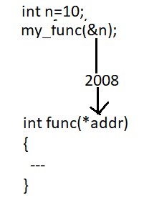

2. Call by reference:
In this method the address of the variable is passed into the function call as the actual parameter.
The address which is used inside the function is used to access the actual argument used in the call.

Slide 18
2. Call by reference:
In this method of parameter passing the formal parameters must be pointer variables.
The changes made on the formal parameters effects the value of actual parameters
#include<stdio.h>
int main()
{
int n=10;
func(&n); //CALL BY REFERECE
printf(“%d”,n);
}
int func(int *p)
{
*p=20;
}
n
10 20
1008
p
1008
2016

Slide 19

2. Call by reference:
Q) Create a C program for Swapping two numbers using call by reference
INPUT: Enter n1= 35 n2= 45
OUTPUT: After swapping n1=45 n2=35
LOGIC:
Read two numbers
Define a function swap()
Call swap() using address
Print the numbers after swappin

Slide 20
//swapping-Program
1
2
3
4
5
6
7
8
9
10
11
12
13
14
#include <stdio.h>
n1
n2
void swap(int *a, int *b){
35
45
int temp;
temp = *a;
a
b
*a = *b;
35
35
45
45
*b = temp;
}
temp
int main(){
35
int n1 = 35, n2 = 45;
Output:
Before swapping: 35, 45
After swapping: 35, 45
printf(“Before swapping:%d, %d”,n1,n2);
swap(&n1, &n2);
printf(“After swapping:%d, %d”, n1, n2;
return 0;
}

Slide 21
Write A function CYCLIC-SWAP that takes 3 numbers and swap them in cyclic order.
Input:
3 numbers
Output:
print numbers in cyclic order
Example -
Input-
Enter a, b and c respectively:
1
2
3
Output
Value before swapping:
a = 3
b = 1
c = 2
Value after swapping:
a = 2
b = 3
c = 1
LOGIC:
temp = *n2;
*n2 = *n1;
*n1 = *n3;
*n3 = temp;
}

Slide 22
//PROGRAM FOR CYCLIC SWAPPING
#include <stdio.h>
void cyclicSwap(int *a, int *b, int *c);
int main() {
int a, b, c;
printf("Enter a, b and c respectively: ");
scanf("%d %d %d", &a, &b, &c);
printf("Value before swapping:\n");
printf("a = %d \nb = %d \nc = %d\n", a, b, c);
cyclicSwap(&a, &b, &c); //CALL BY REFERENCE
printf("Value after swapping:\n");
printf("a = %d \nb = %d \nc = %d", a, b, c);
return 0;
}
//FUNCTION CALL
void cyclicSwap(int *n1, int *n2, int *n3)
{
int temp;
// swapping in cyclic order
temp = *n2;
*n2 = *n1;
*n1 = *n3;
*n3 = temp;
}

Slide 23
return statement
A return statement can return a value and returns control to the calling function
A return statement causes your function to exit and hand back a value to its caller.
The point of functions, in general, is to take in inputs and return something
Syntax:
returntype func_name(parametres)
{
---
return (expression/value);
}
int total ()
{
int a,b,c;
a=10;
b=20;
c=a+b;
return c;
}

Slide 24
return vs. exit():
The return value could be any valid expression that returns a value:
a constant → ex. return 10;
a variable → return sum;
a calculation, for instance (a + b) * c
The default return value for an integer type is 0.
If you do not insert return 0 or any other value in your main() function a, 0 will be returned automatically.
If you want to return an int value in your function, it is preferred to mention the return value in your function header
int main()
{
---
return 0;
}

Slide 25
return vs. exit():
Q) Write a c program to return your percentage when you call that
function with input of your rollnumber
input: 884
Output: Your percentage is : 95.67
LOGIC:
1) Read a rollnumber
2)define a funciton getPercentage() --> use return(percentage) statement
3)call function getPercentage()

Slide 26
return 0 vs. return 1
The return statement with 0 or 1 will denote the execution status.
return 0: a return 0 means that the program will execute successfully and did what it was intended to do.
return 1: a return 1 means that there is some error while executing the program and it is not performing what it was intended to do
#include<stdio.h>
int main()
{
int a,b,c;
printf("enter a and b\n");
scanf("%d%d",&a,&b); //a=20 b=0
if(b==0)
{
printf("Division by zero is not possible.");
return 1;
}
c=a/b;
printf("The result is %d",c);
return 0;
}
Output:
Division by zero is not possible

Slide 27
exit() function
In C, exit() terminates the calling process without executing the rest code which is after the exit() function.
Ex.
The following example shows the usage of exit() function.
#include <stdio.h>
#include <stdlib.h>
int main () {
printf("Start of the program....\n");
printf("Exiting the program....\n");
exit(0);
printf("End of the program....\n");
return 0;
}
Start of the program....
Exiting the program....

